Slide 1
CSE322
LEFT & RIGHT LINEAR REGULAR GRAMMAR
Lecture #18

Slide 2
Grammars

Slide 3

Grammars
Grammars express languages
Example: the English language

Slide 4
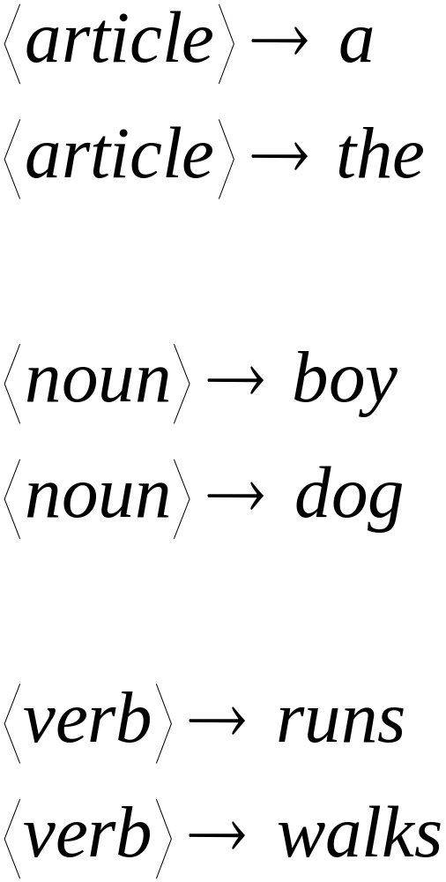

Slide 5
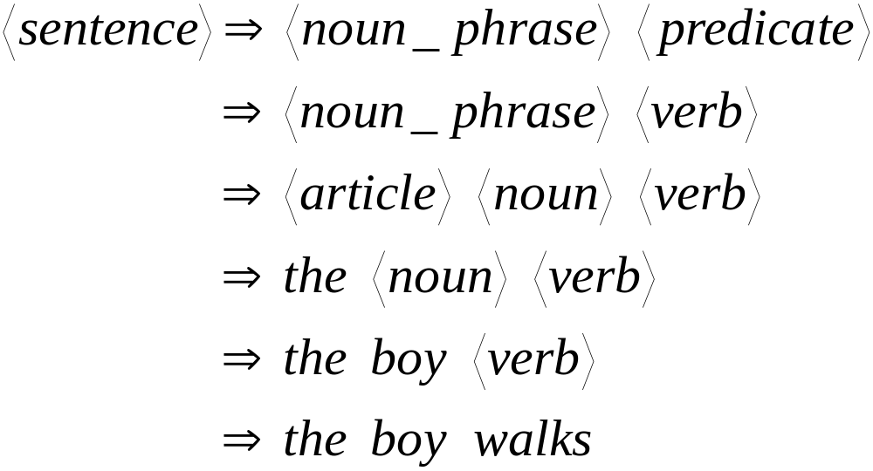
A derivation of “the boy walks”:

Slide 6
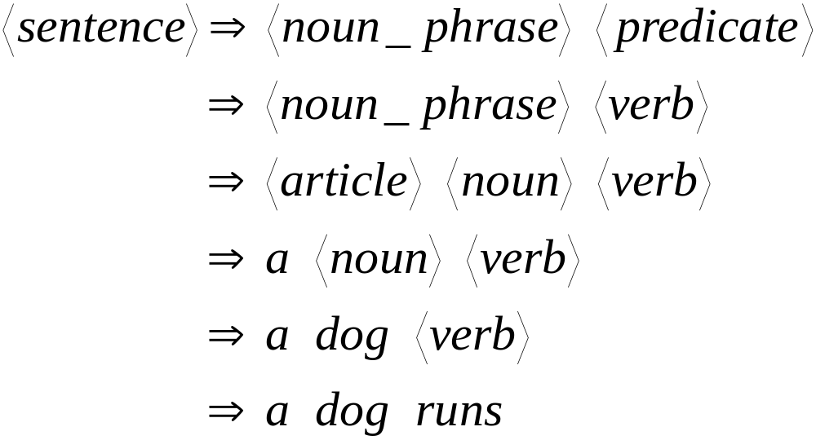
A derivation of “a dog runs”:

Slide 7
Language of the grammar:
L = { “a boy runs”,
“a boy walks”,
“the boy runs”,
“the boy walks”,
“a dog runs”,
“a dog walks”,
“the dog runs”,
“the dog walks” }

Slide 8
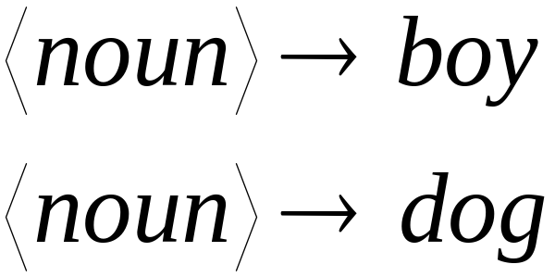
Notation
Variable
or
Non-terminal
Terminal
Production
rule

Slide 9





Another Example
Grammar:
Derivation of sentence :

Slide 10



Grammar:
Derivation of sentence :

Slide 11

Other derivations:

Slide 12

Language of the grammar

Slide 13





More Notation
Grammar
Set of variables
Set of terminal symbols
Start variable
Set of Production rules

Slide 14




Example
Grammar :

Slide 15
More Notation
Sentential Form:
A sentence that contains
variables and terminals
Example:
Sentential Forms
sentence

Slide 16

We write:
Instead of:

Slide 17

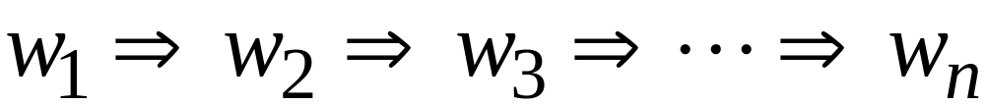
In general we write:
If:

Slide 18
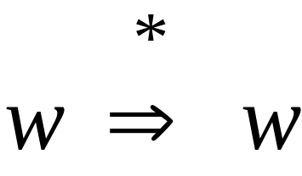
By default:

Slide 19
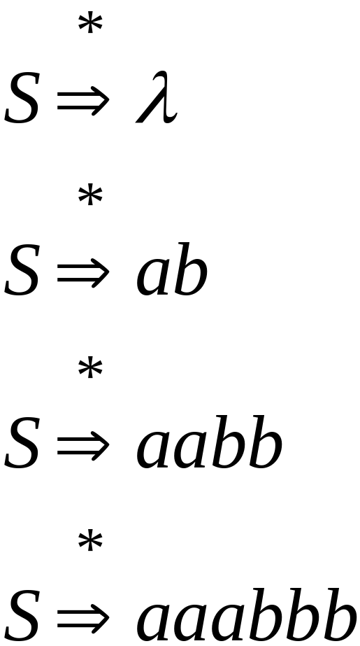
Example
Grammar
Derivations

Slide 20
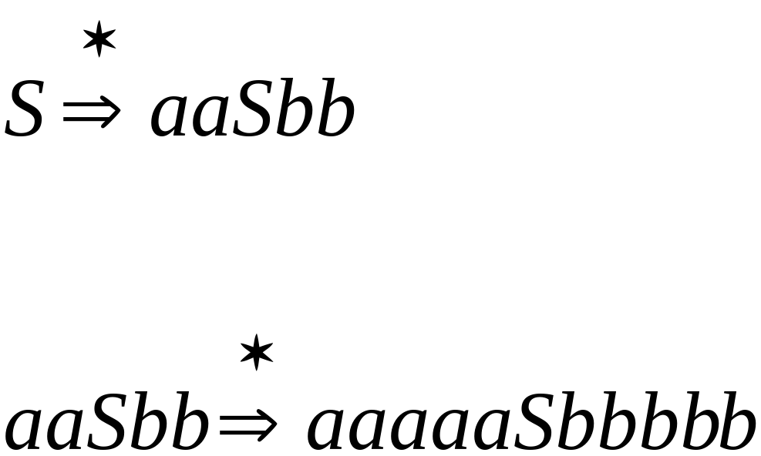
Example
Grammar
Derivations

Slide 21
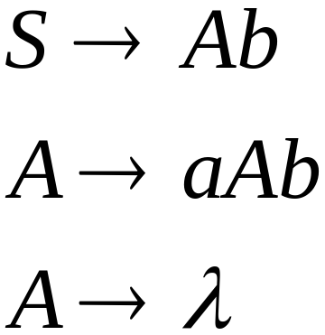
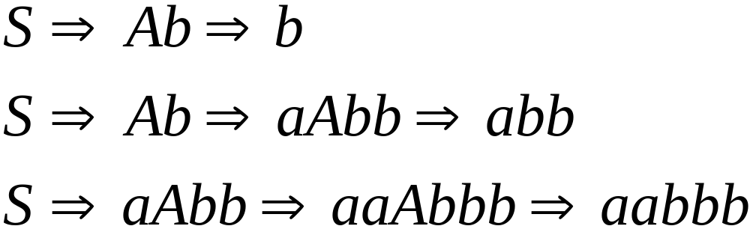
Another Grammar Example
Grammar :
Derivations:

Slide 22
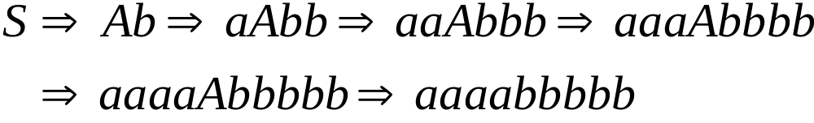
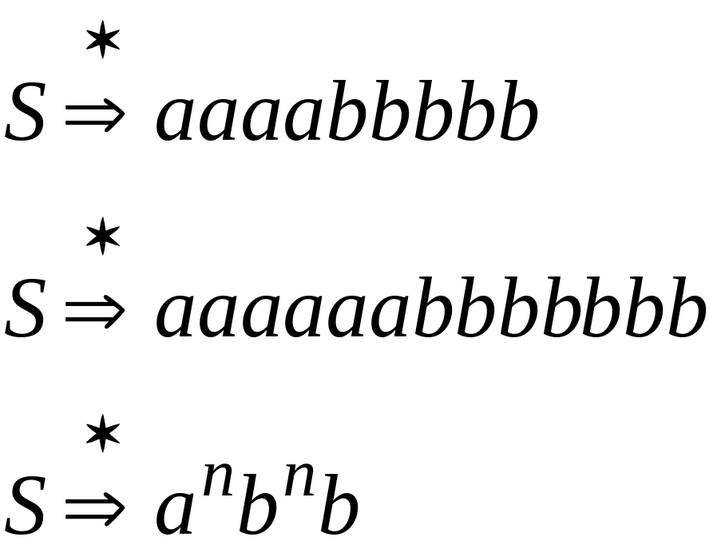
More Derivations

Slide 23

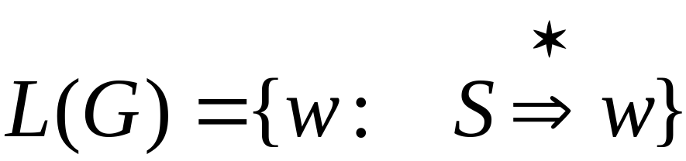
Language of a Grammar
For a grammar
with start variable :
String of terminals

Slide 24

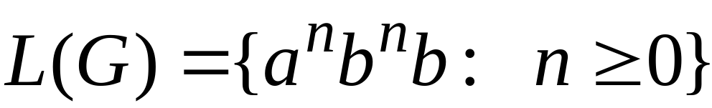
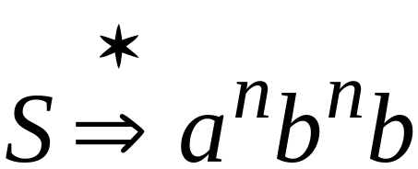
Example
For grammar :
Since:

Slide 25
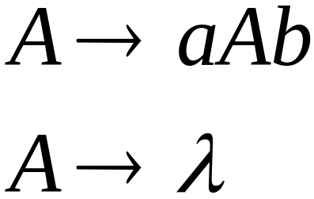
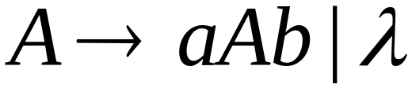
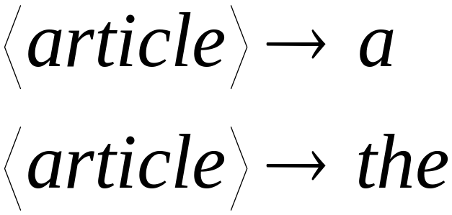
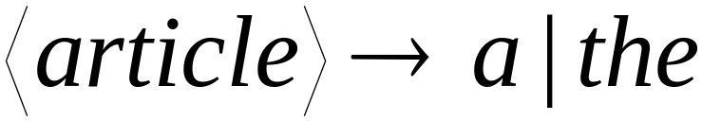
A Convenient Notation

Slide 26
Linear Grammars

Slide 27
Linear Grammars
Grammars with
at most one variable at the right side
of a production
Examples:

Slide 28
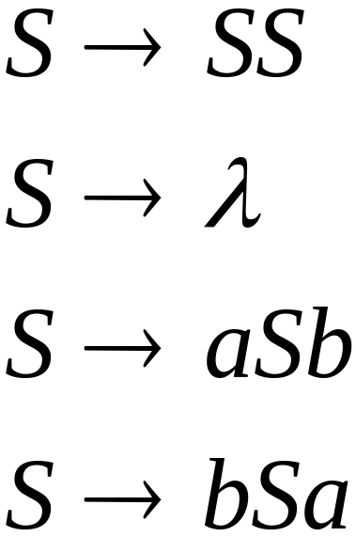
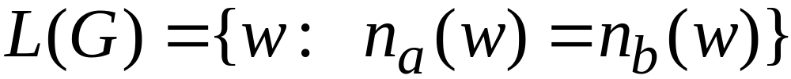
A Non-Linear Grammar
Grammar :

Slide 29
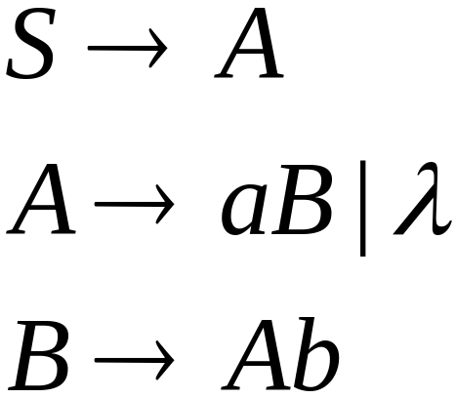
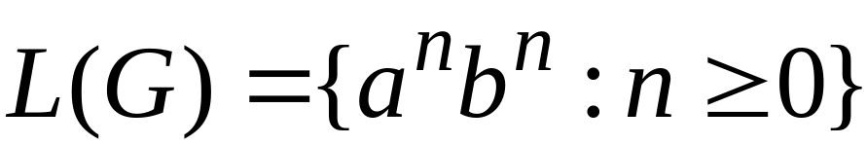
Another Linear Grammar
Grammar :

Slide 30


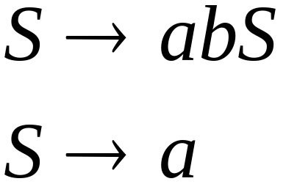
Right-Linear Grammars
All productions have form:
Example:
or

Slide 31

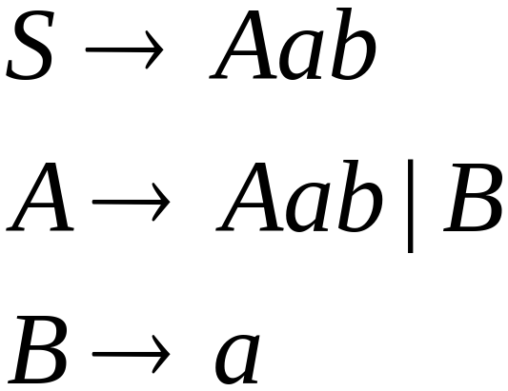
Left-Linear Grammars
All productions have form:
Example:
or

Slide 32
Regular Grammars

Slide 33
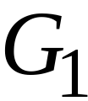
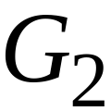
Regular Grammars
A regular grammar is any
right-linear or left-linear grammar
Examples:

Slide 34
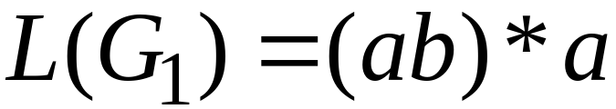
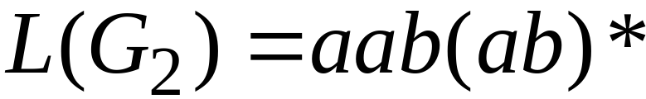
Observation
Regular grammars generate regular languages
Examples:

Slide 35
Regular Grammars
Generate
Regular Languages

Slide 36

Theorem
Languages
Generated by
Regular Grammars
Regular
Languages

Slide 37

Theorem - Part 1
Languages
Generated by
Regular Grammars
Regular
Languages
Any regular grammar generates
a regular language

Slide 38

Theorem - Part 2
Languages
Generated by
Regular Grammars
Regular
Languages
Any regular language is generated
by a regular grammar

